Slide 1


Green Pace
Security Policy Presentation
Developer: Hanah Deering

Slide 2

OVERVIEW: DEFENSE IN DEPTH
To standardize principles and coding standards across all employees at Green Pace, this security policy was introduced. It follows the best security practices such as Defense in Depth and the Triple-A Framework.

Slide 3
THREATS MATRIX
Likely STR50-CPP MEM50-CPP | Priority CTR51-CPP
Low priority ERR50-CPP IDS00-J | Unlikely NUM00-J DCL03-C FIO51-CPP OOP50-CPP MSC50-CPP

Slide 4
10 PRINCIPLES
Validate Input Data
STD-001-CLG | STD-002-CPP | STD-003-CPP | STD-004-CLG | STD-010-CLG
Heed Complier Warnings
STD-001-CLG | STD-005-CPP | STD-005-CPP
Architect and Design for security Policies
STD-004-CLG | STD-007-CPP | STD-009-CPP
Keep It Simple
STD-001-CLG | STD-009-CPP
Default Deny
Adhere to the Principle of Least Privilege
Sanitize Data Sent to Other Systems
STD-003-CPP | STD-004-CLG
Proactive Defense in Depth
Use Effective Quality Assurance Techniques
Adopt a Secure Coding Standard
STD-001-CLG | STD-002-CPP | STD-003-CPP | STD-008-CPP| STD-009-CPP

Slide 5
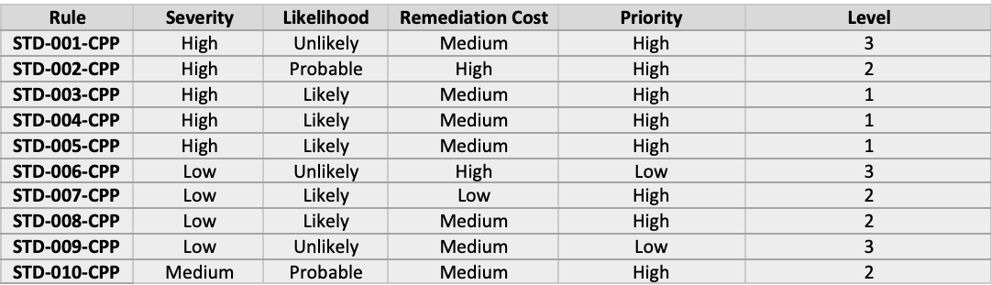
CODING STANDARDS

Slide 6
ENCRYPTION POLICIES
Encryption in Rest
Encryption in rest is used to prevent an attacker from being able to access any unencrypted data. This is done by ensuring that the data on the disk is encrypted. This means that if the attacker only obtains the hard drive and not the encryption keys, the attacker must be able to defeat the encryption to access and read the data on the hard drive.
Encryption at Flight
Encryption at flight means to encrypt data while it is in the process of being transmitted. Some data is not stored on hard drives as encrypted but becomes encrypted while it is being transmitted. This adds a layer of protection to the data.
Encryption in Use
Encryption in used means to enable access to encrypted data both at rest and data in motion. In other words, if somebody has an encryption key, data at rest that is encrypted can be decrypted.

Slide 7
TRIPLE-A POLICIES
Authentication – Who are you?
Authorization – What can you use?
Accounting – What happened and when did it happen?

Slide 8
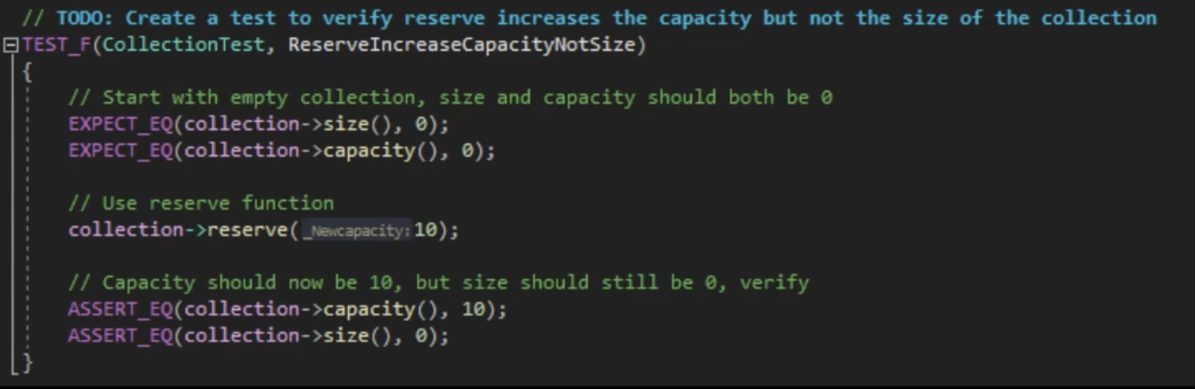
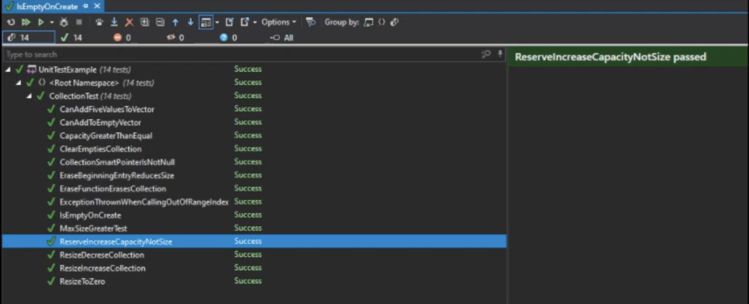
Unit Testing
Memory management is very important when coding applications in C++. Through the use of unit testing, we can check the functionality of resizing/reserving data in memory for a container without allocating any data.

Slide 9

AUTOMATION SUMMARY

Slide 10
TOOLS
DevOps focuses on security protocols from the start; from the designing, building, and testing phases all the way to the production maintenance phases. Following a secure, standardized policy ensures smooth operation at Green Pace.
Various tools will be used throughout many stages. In the “Verify and Test” phase of the process, we use tools such as Clang and Astree. Other external tools will help us to verify the code functionality, detect vulnerabilities in the dependencies, and ensure that all security policies are followed.
DevOps plays a very crucial role.

Slide 11
RISKS AND BENEFITS
DevOps cycle is not security minded in it’s design because of the lack of automation and encryption.
Wait
Less upfront cost and effort
Production cycle unbroken
Most difficult to manage
Act Now
Larger upfront cost and more effort
Designing with security in mind from the beginning of the SDLC
Fewer risks post-production
More secure code, standardized practice for future development

Slide 12
RECOMMENDATIONS
Encrypt everything!
Triple-A Framework
External tools to run vulnerability checks
Unit testing

Slide 13
CONCLUSIONS
Taking the extra steps from the start, implementing Defense in Depth, and incorporating security testing into everyday practice will allow DevOps to be transformed into DevSecOps here at Green Pace. Adopting all standards to improve the security of systems and applications, is a must.

Slide 14
REFERENCES
No references
Thank you for your time!

